Slide 1

Trees(BST)
Data structures & Algorithms
(Venkat & Sakthi)

Slide 2
Tree definition
A Tree can be defined recursively (locally) as a collection of nodes (starting at a root node), where each node is a data structure consisting of a value, together with a list of references to nodes (the "children"), with the constraints that no reference is duplicated, and none points to the root.

Slide 3
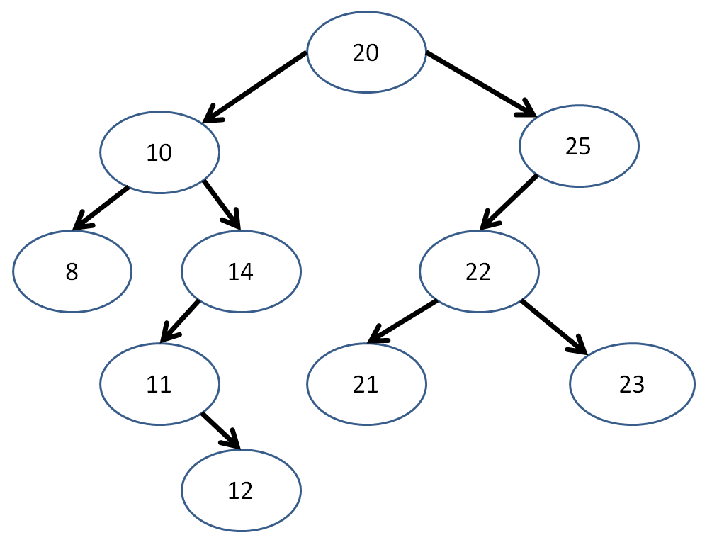
Tree terminology
Root
Child
Parent
Siblings
Descendant
Ancestor
Leaf
Internal node
External node

Slide 4
Tree terminology
Degree
Edge
Path
Level
Height of node
Height of tree
Depth
Forest

Slide 5
Binary Tree
A Tree with where the degree of a every node in the tree is lies between zero and two (including both).

Slide 6
Binary Search Tree (BST)
A Binary Tree in which:
Every internal node's left and right subtrees are BST
Maximum(Left Subtree) < Node
Minimum(Right Subtree) > Node

Slide 7
Question 1
Given a binary Tree and two nodes say ‘p’ and ‘q’, determine whether the two nodes are cousins of each other or not.

Slide 8
Question 2
Given two binary trees, write a function to check if they are equal or not.

Slide 9
Question 3
Given a binary tree, how do you remove leaves of it?

Slide 10
Question 4
Given two binary trees T1 and T2, Find whether T2 is a subtree of T1?

Slide 11
Question 5
Given a binary tree, connect all the nodes at the same level. Each node will have a next pointer; you have to make it point to the next node to its right in the same level. If there is no such node, make it point to null.

Slide 12
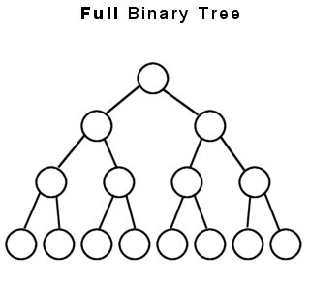
Full Binary Tree
A full binary tree (sometimes proper binary tree or 2-tree) is a tree in which every node other than the leaves has two children

Slide 13
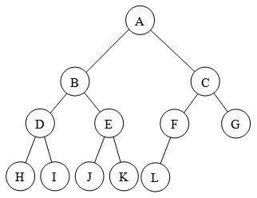
Full Complete Binary Tree Binary Trees
A complete binary tree is a binary tree in which every level, except possibly the last, is completely filled, and all nodes are as far left as possible

Slide 14

Question 6
Consider an n-node complete binary tree T, where n = 2^d - 1 for some d. Each node v of T is labeled with a real number $x_{v}$. You may assume that the real numbers labeling the nodes are all distinct. A node v of T is local minimum if the label $x_{v}$ is less than the label $x_{w}$ for all nodes w that are joined to v by an edge.
You are given such a complete binary tree T, but the labeling is only specified in the following implicit way:
for each node v, you can determine the value $x_{v}$ by probing the node v. Show how to find a local minimum of T using only O(log n) probes to the nodes of T.

Slide 15
Question 7
Show that the second smallest of n elements can be found with n + log n -2 comparisons. Design a divide and conquer algorithm to find the smallest element first.

Slide 16
http://www.gessa.org

Slide 17
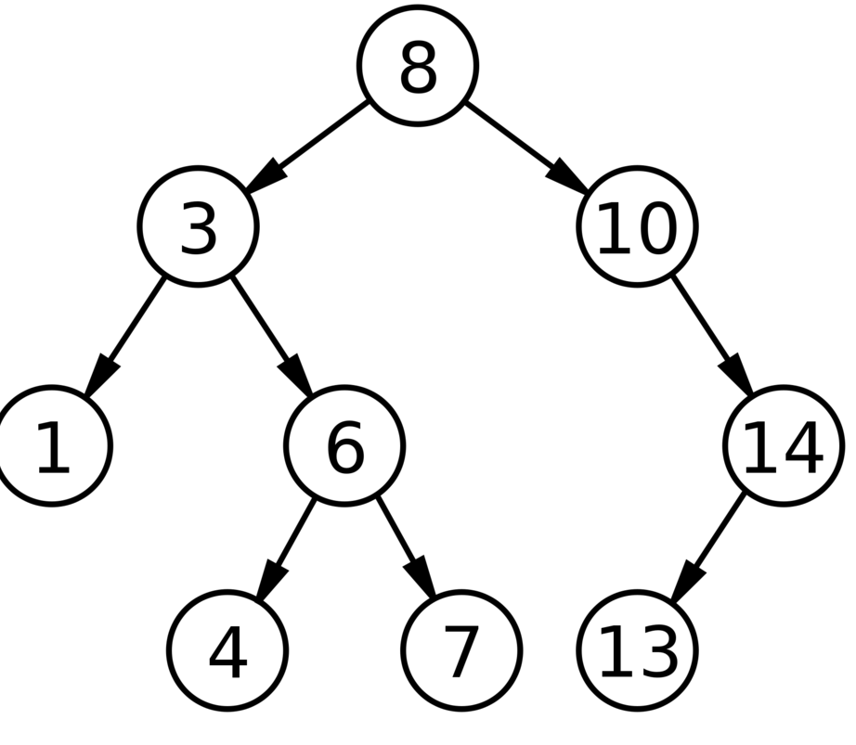
Check sum of Covered and Uncovered nodes of Binary Tree
In a binary tree, a node is called Uncovered if it appears either on left boundary or right boundary. Rest of the nodes are called covered.
In above binary tree,
Covered node: 6, 4, 7
Uncovered node: 8, 3, 1, 10, 14, 13
The output for this tree should be false as
sum of covered and uncovered node is not same
https://www.interviewcake.com/question/python/second-largest-item-in-bst

Slide 18
Path Sum
Given a binary tree and a sum, determine if the tree has a root-to-leaf path such that adding up all the values along the path equals the given sum.
For example:
Given the below binary tree and sum = 22,
5
/ \
4 8
/ / \
11 13 4
/ \ \
7 2 1
return true, as there exist a root-to-leaf path 5->4->11->2 which sum is 22.
https://leetcode.com/problems/path-sum/

Slide 19
Path Sum Part II
Given a binary tree and a sum, find all root-to-leaf paths where each path's sum equals the given sum.
For example:
Given the below binary tree and sum = 22,
5
/ \
4 8
/ / \
11 13 4
/ \ / \
7 2 5 1
return
[
[5,4,11,2],
[5,8,4,5]
]
https://leetcode.com/problems/path-sum-ii/

Slide 20
Second largest element in BST
Write a function to find the 2nd largest element in a binary search tree ↴ .
https://www.interviewcake.com/question/python/second-largest-item-in-bst

Slide 21
Height-balanced tree
How to determine if a binary tree is height-balanced?
http://www.geeksforgeeks.org/how-to-determine-if-a-binary-tree-is-balanced/

Slide 22
Second largest element in BST
Given a binary search tree, write a function kthSmallest to find the kth smallest element in it.
Note:
You may assume k is always valid, 1 ≤ k ≤ BST's total elements.
Follow up:
What if the BST is modified (insert/delete operations) often and you need to find the kth smallest frequently? How would you optimize the kthSmallest routine?
Hint:
Try to utilize the property of a BST.
What if you could modify the BST node's structure?
The optimal runtime complexity is O(height of BST).
https://www.interviewcake.com/question/python/second-largest-item-in-bst

